Slide 1
Social Psychology

Slide 2
Social Psychology
Social psychology: the scientific study of how we think about, influence, and relate to one another.
Activity: Attribution scale

Slide 3
Attribution Theory
Attribution: a claim about the cause of someone’s behavior.
Attribution Theory
The theory in which we explain someone’s behavior by crediting either the situation or the person’s disposition.
Dispositional attribution vs. situational attribution.

Slide 4
Attribution Theory
Three questions we ask when we make an attribution:
Does this person regularly behave this way in this situation?
Do many other people regularly behave this way in this situation?
Does this person behave this way in many other situations?

Slide 5
Fundamental Attribution Error
Fundamental Attribution Error
The tendency for observers, when analyzing another’s behavior, to overestimate the influence of personality and underestimate the influence of situations.
Partially due to heuristics (e.g. cognitive shortcut when tired or preoccupied).
Score the assessment.
We experience ourselves in all different situations, but others in only a few situations.

Slide 6
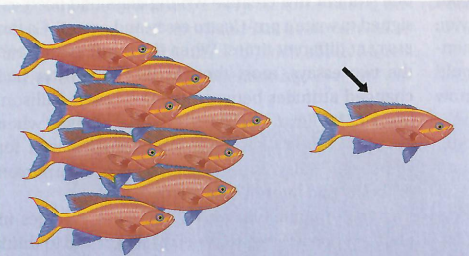
Fundamental Attribution Error
Describe the behavior of the fish with the arrow above it.

Slide 7
Fundamental Attribution Error
Cultural differences
Individualist societies tend to make more dispositional attributions.
Collectivist societies tend to make more situational attributions.

Slide 8
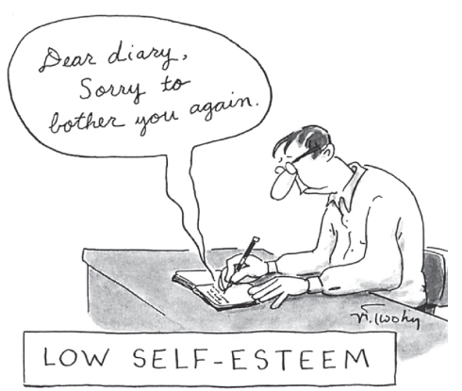
Self-Esteem
Self-esteem: one’s feeling of approval and acceptance of oneself.
Rather than being derived from one’s own self-judgment, self esteem is based largely on a person’s sense of others’ attitudes toward oneself.
Looking glass self: we infer what others think of us from their reactions and use those inferences to build our own self-concepts.
Evolutionary purpose of self-esteem: to motivate us to act in ways that promote our acceptance by others.

Slide 9
Perceptions of Self
Self-fulfilling prophecy/ Pygmalion effect
When beliefs and expectations of others create reality by influencing a person’s self-concept and behavior.
Self-serving bias
The tendency of people to attribute their successes to their own inner qualities and their failures to the situation.
Self-handicapping strategies
When people intentionally put themselves at a disadvantage to provide an excuse for failure.

Slide 10
Attitudes
Feelings, often influenced by our beliefs, that predispose us to respond in a particular way to objects, people, and events.
Tendency to evaluate stimuli with some degree of favor or disfavor.
Have affective, behavioral, and cognitive component.
Affective: feelings, influenced by memories, personal experiences, etc.
Behavioral: can influenced by external sources and our own cognition.
Cognition: beliefs, knowledge.

Slide 11
Attitudes
Attitudes ↔ Behavior
Attitudes influence behavior.
Behavior influences attitudes.
Doing becomes believing.
Role-playing
Stanford Prison experiment:
https://www.youtube.com/watch?v=sZwfNs1pqG0

Slide 12
Attitudes
Foot-in-door phenomenon: tendency for people who have first agreed to a small request to comply later with a larger request.
Cognitive dissonance: theory that we act in reduce the discomfort (dissonance) we feel when our thoughts (cognitions) are inconsistent with our behaviors.

Slide 13
Social Influence: Conformity
Conformity: adjusting one’s behavior or thinking to coincide with a group standard.
https://www.youtube.com/watch?v=NyDDyT1lDhA
Normative social influence: influence resulting from a person’s desire to gain approval or avoid disapproval.
Normative influence is stronger when task is easy.
Informational social influence: influence resulting from one’s willingness to accept others’ opinions about reality.
Informational influence is stronger when task is difficult or ambiguous.

Slide 14
Social Influence: Conformity
Conformity increases when:
Group has three or more people.
Group is unanimous.
One’s behavior is observed.
One is made to feel incompetent or insecure.
Cultural differences in conformity.

Slide 15
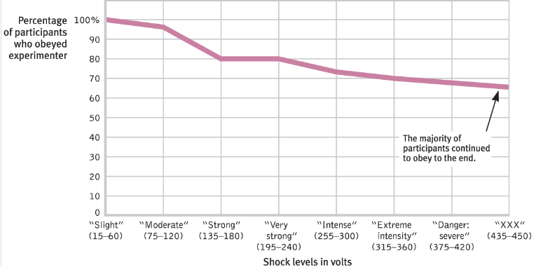
Social Influence: Obedience
Milgram’s obedience studies:
https://www.youtube.com/watch?v=Kzd6Ew3TraA

Slide 16
Social Influence: Obedience
Obedience is highest when:
Person giving orders is close at hand.
Victim was depersonalized or at a distance.
Person giving order is perceived to be a legitimate authority figure.
Authority figure was associated with a prestigious institution.
No role models for defiance.

Slide 17
Group Influence
Social facilitation: stronger responses on simple or well-learned tasks in the presence of others.
Arousal strengthens the most likely response.
Choking under pressure: pressure creates distracting thoughts that interfere with the limited capacity of working memory.

Slide 18
Group Influence
Social loafing: tendency for people in a group to exert less effort when pooling their efforts toward attaining a common goal than when individually accountable.
View individual contributions as dispensable.
Less likely to loaf if you are personally highly motivated or if you strongly identify with the group.

Slide 19
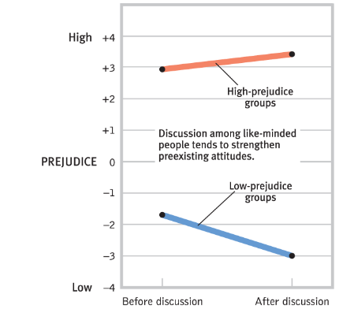
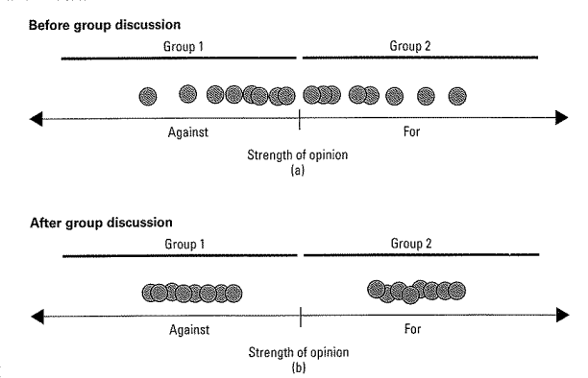
Group Interaction
Group polarization: the enhancement of a group’s prevailing inclinations through discussion within the group.

Slide 20
Group Interaction
Groupthink: the mode of thinking that occurs when desire for harmony in a decision-making group overrides a realistic appraisal of alternatives.
Members of a group suppress their doubts about a group’s decision for fear of disrupting group harmony.
Preventable if:
A leader welcomes various opinions.
Leader refrains from advocating their own view.
Invite expert critiques.
Assign people to identify possible problems.

Slide 21
Prejudice
Personal identity vs. Social identity
Self-esteem depends not only on our accomplishments, but on the achievements of the groups with which we identify.
In-group bias: favoring of our own group (“us vs. them”).
Stereotype: a generalized belief about a group of people.
When we view others in terms of their social identities rather than their personal identities.
Rely on heuristics.

Slide 22
Prejudice
Prejudice: an unjustifiable (and usually negative) attitude toward a group and its members.
Generally involves stereotyped beliefs, negative feelings, and predisposition to discriminatory action.
Can be explicit or implicit.
Implicit attitudes:
Micro-aggressions, non-verbal behavior
Unconscious group associations (IAT)
https://implicit.harvard.edu/implicit/selectatest.html

Slide 23
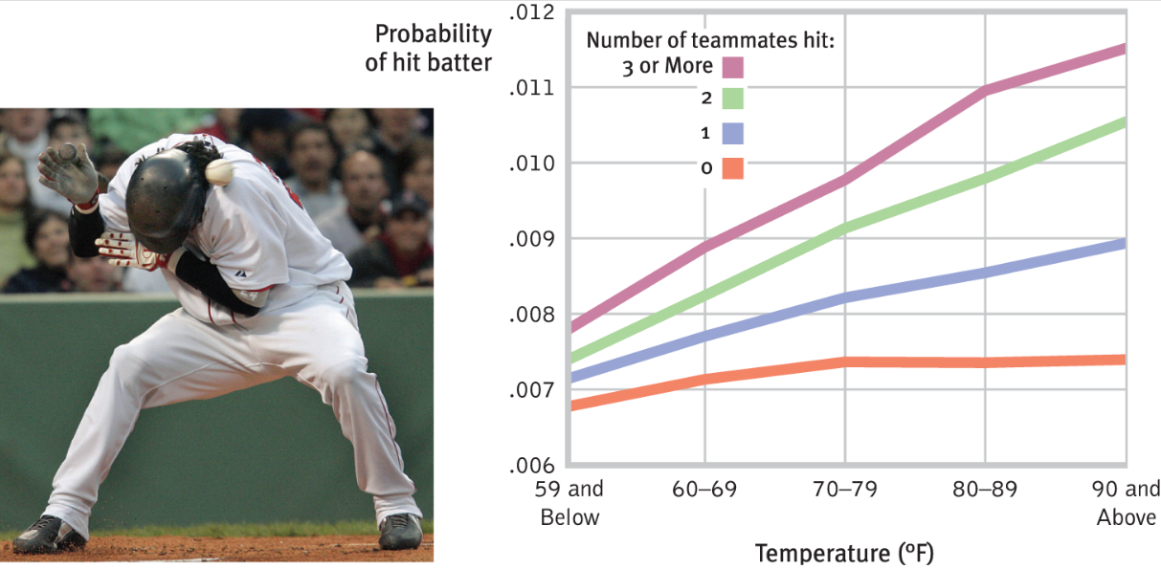
Aggression
Aggression: any physical or verbal behavior intended to harm.
Biochemical influences (e.g. hormones, alcohol, drugs).
Reinforcement and modeling.
Frustration-aggression principle: frustration creates anger, which can generate aggression.

Slide 24
Attraction
Proximity
Mere exposure effect: phenomenon that repeated exposure to novel stimuli increases liking of them.
Physical attractiveness
First impressions
Similarity

Slide 25
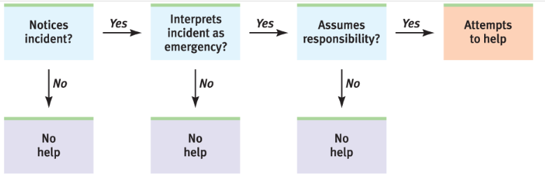
Altruism
Altruism: an unselfish concern for the welfare of others.
Bystander effect: the tendency for any given bystander to be less likely to give aid if other bystanders are present.
Diffusion of responsibility
https://www.youtube.com/watch?v=OSsPfbup0ac

Slide 26
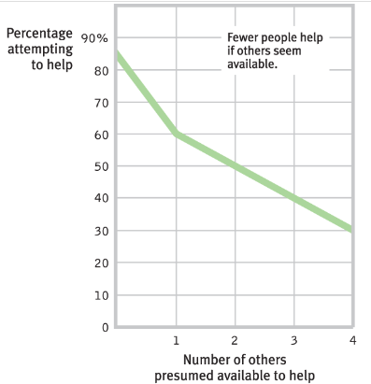
Altruism
Odds of helping highest when:
Person appears to need and deserve help.
Person is similar to us in some way.
We have just observed someone else being helpful.
In a good mood (feel-good-do-good phenomenon).
In a small town or rural area.
Not in a hurry.
No bystanders.

Slide 27
Prosocial Relations
Social exchange theory
Theory that our social behavior is an exchange process, the aim of which is to maximize benefits and minimize costs.
Cost-benefit analysis of social interactions.
Reciprocity norm: the expectation that we should return help to those who have helped us.
Social responsibility norm: the expectation that we should help those who need our help, even if the costs outweigh the benefits.

Slide 28
Class Activity
Form four groups.
Each group will get 2 notecards.

Slide 29
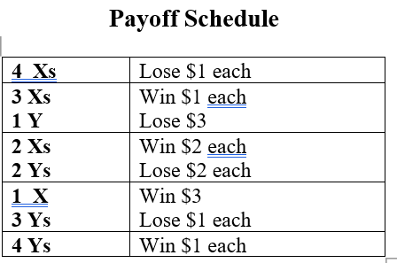
Win As Much As You Can
Objective: to get the highest positive score.
10 rounds
Round 5: points x3.
Round 8: points x5.
Round 10: points x10
Representatives confer before rounds 5, 8, and 10.

Slide 30
Social Dilemmas
Social trap: a situation in which the conflicting parties, by each rationally pursuing their self-interest, become caught in mutually destructive behavior.
Prisoner’s dilemma
Public goods games
Ultimatum games
Realistic Conflict Theory
https://www.youtube.com/watch?v=8PRuxMprSDQ

Slide 31
Social Dilemmas
To decrease conflict and increase cooperation:
Contact
Superordinate goals: shared goals that override differences among people and require their cooperation.
Shared social identity.
Communication (with mediator, if needed).
Conciliation: initiating one or more small, conciliatory acts to lessen the hostility.

